Slide 1
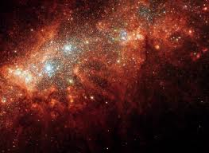
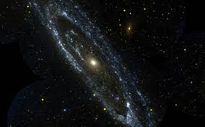
Characteristics of Stars

Slide 2
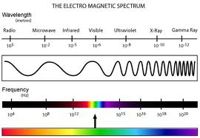
Electromagnetic radiation can be described in terms of a stream of photons traveling in a wave-like pattern and moving at the speed of light.
The only difference between the types of electromagnetic radiation is the amount of energy found in the photons.
The electromagnetic spectrum can be expressed in terms of energy, wavelength, or frequency.

Slide 3
Color and Temperature
Most stars are currently classified using the letters O, B, A, F, G, K, and M (usually memorized by astrophysicists as "Oh, be a fine girl/guy, kiss me”)
O stars are the hottest and the letter sequence indicates successively cooler stars up to the coolest M class.
O stars are called "blue", B "blue-white", A stars "white", F stars "yellow-white", G stars "yellow", K stars "orange", and M stars "red",

Slide 4
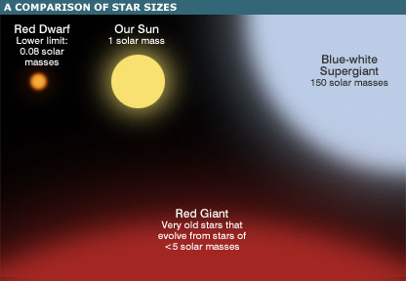

Slide 5
Chemical Composition
A spectrograph is a device that breaks light into colors and produces an image of the spectrum.
Gases in a star’s atmosphere absorb some wavelengths of light produced within the star.
When viewed through a spectrograph, each absorbed wavelength is shown as a dark line on a spectrum
Each chemical element absorbs light at particular wavelengths. Each element has it’s own unique set of lines.
By comparing a star’s spectrum with the spectrum of known elements we can infer how much of each element is found in the star

Slide 6
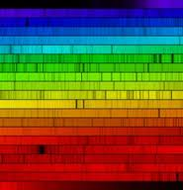
Look at the Skills Activity on page 754
In star A, which elements have the strongest lines?
Which are the strongest in star B?
In star C?

Slide 7
Brightness of Stars
Apparent Brightness
A star’s brightness as seen from Earth.
Problem: Can’t tell how much light a star gives off: A flashlight will look brighter if it is closer to you.
Absolute Brightness
The brightness the star would have if it were at a standard distance from Earth.
Must know the apparent brightness and the star’s distance from Earth to calculate

Slide 8
Measuring Distances to Stars
Light Year
A unit of distance NOT time
Light travels at a speed of about 300,000 km/s
A light year=the distance that light travels in one year
9.5 million million km
Parallax
The apparent change in position of an object when you look at it from different places.
Nearby objects have a larger parallax than more distant objects when observed from different positions

Slide 9
You can see the parallax effect in action by holding your thumb out at arm's length and following the simple instructions below.
Part 1:
Stretch your arm out in front of your face with your thumb extended upwards.
Leaving your arm still, close your left eye and note where your thumb appears in relation to fixed objects in the distance.
Now close your right eye and open the left. Note that even though you have not moved your thumb, the position of your thumb with respect to the background has shifted slightly to the right compared to where it was when only your right eye was open.
Repeat several times, shifting your view from your left eye to your right eye, and then to your left, back and forth.
This apparent shift in position is known as parallax,

Slide 10
Part 2:
Repeat Part 1.
Now move your thumb so that it is very close to your face, and repeat Part 1 again.
What do you notice?
The closer your thumb (the object you look at), the more it seems to shift when you switch eyes. Thus the amount of shift (parallax) is related to the distance to the object.

Slide 11
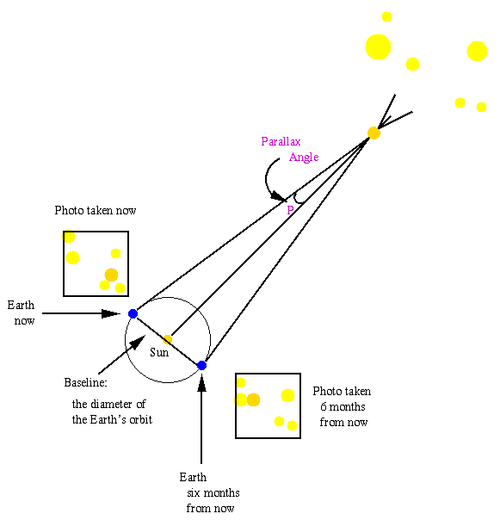

Slide 12
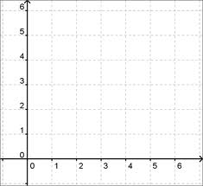
Hertzsprung-Russell Diagram H-R Diagram
The vertical axis represents the star’s luminosity or absolute magnitude. Luminosity is technically the amount of energy a star radiates in one second, but you can think of it as how bright or how dim the star appears
The horizontal axis represents the star’s surface temperature in Kelvin (K)
Astronomers use H-R diagrams to classify stars to to understand how stars change over time.

Slide 13
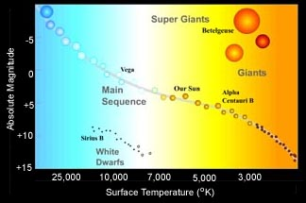

Slide 14
H-R diagram
Most stars (90%) are found in the main sequence area
Hottest/Brightest=top left
Hottest/dimmest-bottom left
Coolest/Brightest=top right
Coolest/dimmest=bottom right

