Slide 1
Unit 1 Lesson 3 Erosion and Deposition by Water
Copyright © Houghton Mifflin Harcourt Publishing Company

Slide 2
Unit 1 Lesson 3 Erosion and Deposition by Water
Go with the Flow
How does flowing water change Earth’s surface?
Rivers and streams erode soil, rock, and sediment. Sediment is tiny grains of broken-down rock.
Erosion is the process by which sediment and other materials are moved from one place to another.
Erosion causes changes to Earth’s surface.
Copyright © Houghton Mifflin Harcourt Publishing Company
Notes:
2

Slide 3
Unit 1 Lesson 3 Erosion and Deposition by Water
How does flowing water change Earth’s surface?
Materials in rivers and streams are eventually dropped, or deposited, downstream.
Deposition is the process by which eroded material is dropped.
Deposition occurs when gravity’s downward pull on sediment is greater than the push of flowing water or wind.
Copyright © Houghton Mifflin Harcourt Publishing Company
Notes:
3

Slide 4
Unit 1 Lesson 3 Erosion and Deposition by Water
What factors relate to a stream’s ability to erode material?
A stream’s gradient, discharge, and load are the three main factors that control what sediment a stream can carry.
Gradient is the measure of the change in elevation over a certain distance.
Rapid water flow over a steep gradient gives a stream a lot of energy to carry rock and soil.
Copyright © Houghton Mifflin Harcourt Publishing Company
Notes:
4

Slide 5
Unit 1 Lesson 3 Erosion and Deposition by Water
What factors relate to a stream’s ability to erode material?
Load refers to the materials carried by a stream.
The size of the particles in a stream’s load is affected by the stream’s speed.
Fast-moving streams can carry large particles and have a high erosion rate.
Slow-moving streams have smaller particles and have less erosive energy.
Copyright © Houghton Mifflin Harcourt Publishing Company
Notes:
5

Slide 6
Unit 1 Lesson 3 Erosion and Deposition by Water
What factors relate to a stream’s ability to erode material?
Discharge refers to the amount of water that a stream carries in a given amount of time.
Stream discharge increases after large storms and rapid snow melts.
As a stream’s discharge increases, its erosive energy, speed, and load increase.
Copyright © Houghton Mifflin Harcourt Publishing Company
Notes:
6

Slide 7
Unit 1 Lesson 3 Erosion and Deposition by Water
Run of a River
What landforms can streams create?
A stream forms as water erodes soil and rock to make a channel. A channel is the path that a stream follows.
Landforms, such as canyons and valleys, are created by the flow of water through streams and rivers.
Copyright © Houghton Mifflin Harcourt Publishing Company
Notes:
7

Slide 8
Unit 1 Lesson 3 Erosion and Deposition by Water
What landforms can streams create?
When a stream floods, a layer of sediment is deposited over the flooded land.
A floodplain is a flat area formed from many layers of deposited sediment.
Sediment often contains nutrients for plant growth. As a result, floodplains are often very fertile.
Copyright © Houghton Mifflin Harcourt Publishing Company
Notes:
8

Slide 9
Unit 1 Lesson 3 Erosion and Deposition by Water
What landforms can streams create?
Curves and bends in a stream channel are called meanders.
Moving water erodes the outside banks and deposits sediment along the inside banks.
During a flood, a meander can be cut off, forming a crescent-shaped lake called an oxbow lake.
Copyright © Houghton Mifflin Harcourt Publishing Company
Notes:
9

Slide 10
Unit 1 Lesson 3 Erosion and Deposition by Water
What landforms can streams create?
When a stream empties into another body of water, its current slows and it deposits its load.
A delta is a fan-shaped pattern of deposited sediment load.
An alluvial fan is a fan-shaped deposit that forms on dry land.
Copyright © Houghton Mifflin Harcourt Publishing Company
Notes:
10

Slide 11
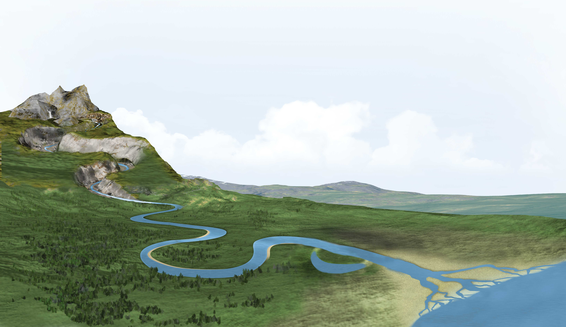
Unit 1 Lesson 3 Erosion and Deposition by Water
What landforms can streams create?
Copyright © Houghton Mifflin Harcourt Publishing Company
Notes:
11

Slide 12
Unit 1 Lesson 3 Erosion and Deposition by Water
More Waterworks
What landforms are made by groundwater erosion?
Groundwater is the water located within the rocks below Earth’s surface. Acidic groundwater can dissolve rock, forming underground caves.
Water dripping from cracks in a cave’s ceiling leaves behind icicle-shaped deposits called stalactites and stalagmites.
If the roof of a cave collapses, it may leave a circular depression called a sinkhole.
Copyright © Houghton Mifflin Harcourt Publishing Company
Notes:
12

Slide 13
Unit 1 Lesson 3 Erosion and Deposition by Water
What forces shape a shoreline?
A shoreline is the place where land and a body of water meet.
Ocean waves and currents, or streamlike movements of water, can erode and deposit materials.
Copyright © Houghton Mifflin Harcourt Publishing Company
Notes:
13

Slide 14
Unit 1 Lesson 3 Erosion and Deposition by Water
What forces shape a shoreline?
Waves slow down as they approach a shoreline.
The first parts of the shoreline that waves meet are the headlands, or pieces of land that project into the water.
Waves striking headlands have high energy and erode materials. Waves striking areas between headlands have less energy and deposit materials.
Copyright © Houghton Mifflin Harcourt Publishing Company
Notes:
14

Slide 15
Unit 1 Lesson 3 Erosion and Deposition by Water
What forces shape a shoreline?
Longshore currents are currents that travel almost parallel to the shoreline very near shore.
Longshore currents are caused by waves hitting the shore at an angle.
As sand moves down a beach, the upcurrent end of the beach is eroded away while the downcurrent end of the beach is built up.
Copyright © Houghton Mifflin Harcourt Publishing Company
Notes:
15

Slide 16
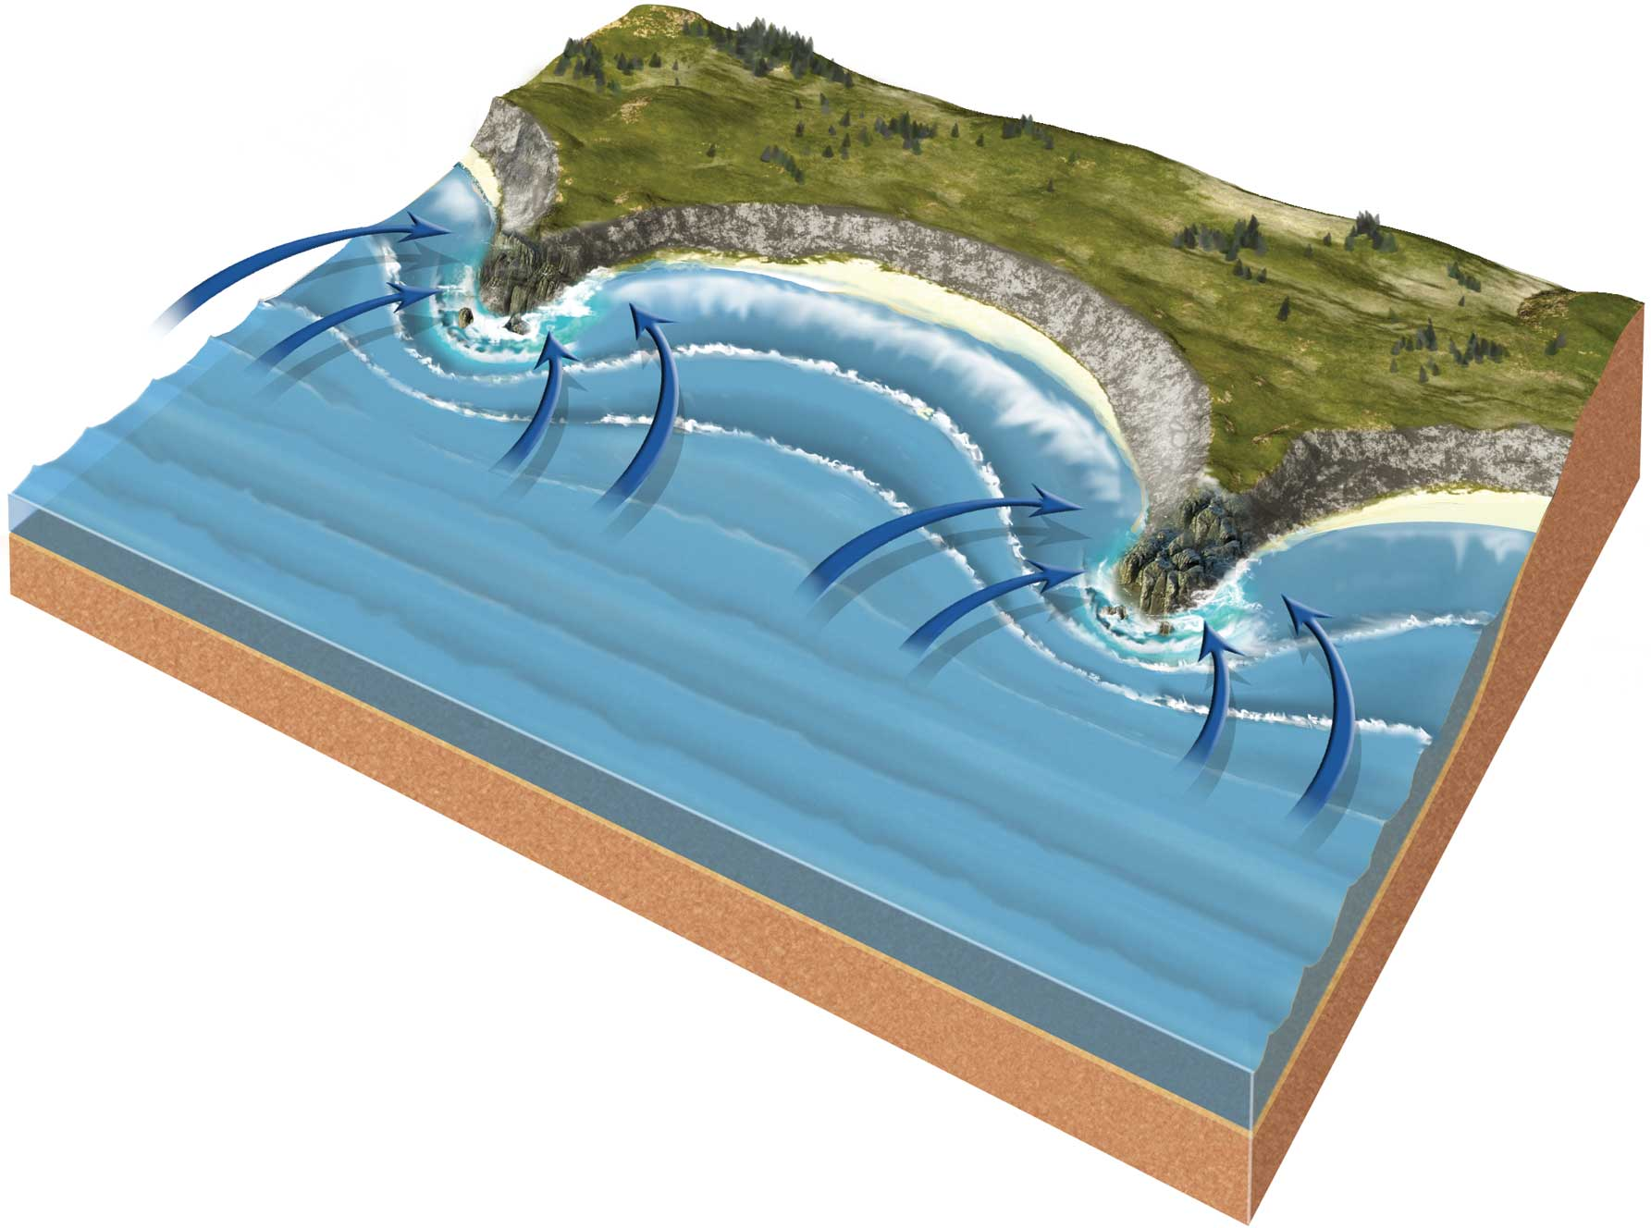
Unit 1 Lesson 3 Erosion and Deposition by Water
What forces shape a shoreline?
What might this beach area look like in the future?
Copyright © Houghton Mifflin Harcourt Publishing Company
Notes:
16

Slide 17
Unit 1 Lesson 3 Erosion and Deposition by Water
Surf Versus Turf
What coastal landforms are made by erosion?
The rate at which rock erodes depends on the hardness of the rock and the energy of the waves.
Gentle waves cause little erosion.
Strong waves from heavy storms can increase the rate of erosion.
Copyright © Houghton Mifflin Harcourt Publishing Company
Notes:
17

Slide 18
Unit 1 Lesson 3 Erosion and Deposition by Water
What coastal landforms are made by erosion?
Very hard rock can slow the rate of erosion because it takes more wave energy to break the rock.
Soft rock erodes more rapidly.
Bays, sea caves, wave-cut platforms, and headlands can form as a result of differences in the hardness of rock.
Copyright © Houghton Mifflin Harcourt Publishing Company
Notes:
18

Slide 19
Unit 1 Lesson 3 Erosion and Deposition by Water
What coastal landforms are made by erosion?
A sea cliff forms when waves erode and undercut rock to make steep slopes.
As a sea cliff erodes above the waterline, a bench of rock, called a wave-cut platform, can remain below the waterline.
The erosion of sea cliffs and headlands can create holes that become sea caves. Further erosion can produce a sea arch and sea stacks.
Copyright © Houghton Mifflin Harcourt Publishing Company
Notes:
19

Slide 20
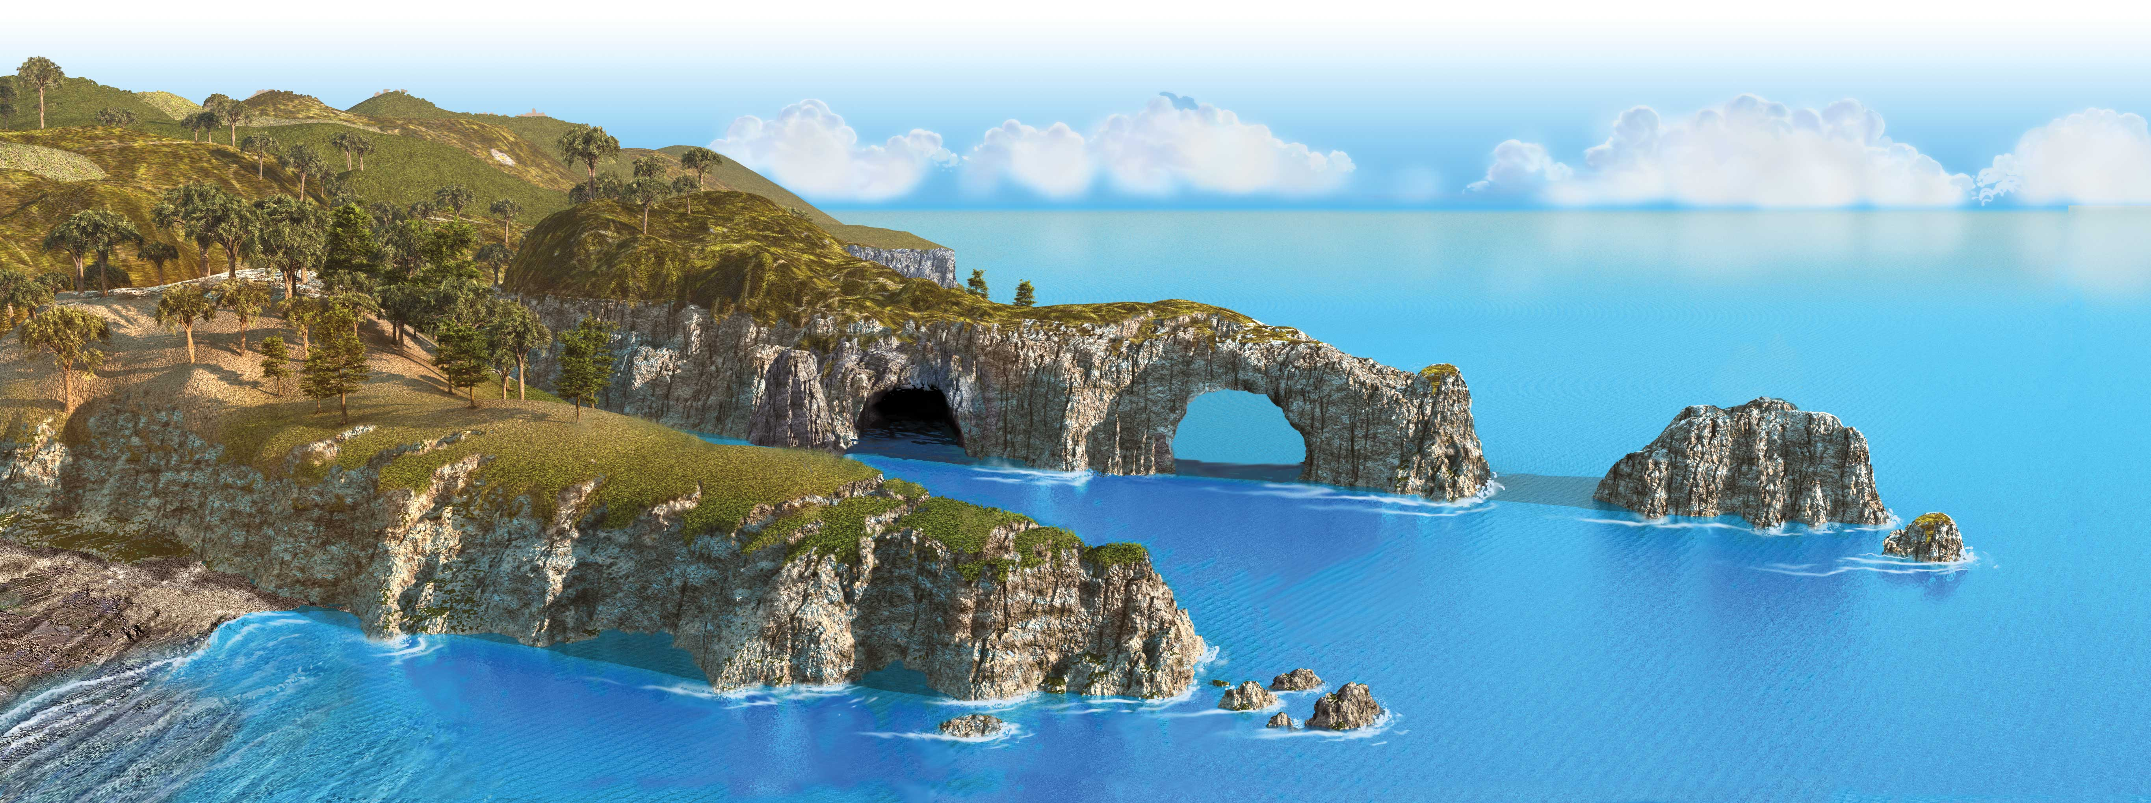
Unit 1 Lesson 3 Erosion and Deposition by Water
What coastal landforms are made by erosion?
What landforms can you identify in the image below? How did each landform form?
Copyright © Houghton Mifflin Harcourt Publishing Company
Notes:
20

Slide 21
Unit 1 Lesson 3 Erosion and Deposition by Water
Shifting Sands
What coastal landforms are made by deposition?
A beach is an area of shoreline that is made up of material deposited by waves and currents.
The size and shape of materials on a beach depend on how far the material has traveled, the type of material, and how it is eroded.
Copyright © Houghton Mifflin Harcourt Publishing Company
Notes:
21

Slide 22
Unit 1 Lesson 3 Erosion and Deposition by Water
What coastal landforms are made by deposition?
A sandbar is an underwater or exposed ridge of sand, gravel, or shell material.
A barrier island is a long, narrow island, usually made of sand, that forms parallel to the shoreline a short distance offshore.
Copyright © Houghton Mifflin Harcourt Publishing Company
Notes:
22

Slide 23
Unit 1 Lesson 3 Erosion and Deposition by Water
Living on the Edge
Barrier islands are found all over the world.
Barrier islands can change shape and be eroded away by tides and large storms.
Barrier island erosion can be slowed down by using sandbags and other anti-erosion techniques.
Copyright © Houghton Mifflin Harcourt Publishing Company
Notes:
23

