Slide 1
Basic Concepts
in Genetics
Notes:
References:
Kenneth Lange “Mathematical and Statistical Methods for Genetic Analysis”
Jurg Ott “Analysis of Human Genetic Linkage”
http://www.accessexcellence.com/AB/GG/
http://www.nhgri.nih.gov/DIR/VIP/Glossary/index.html
http://www.tokyo-med.ac.jp/genet/index-e.htm

Slide 2
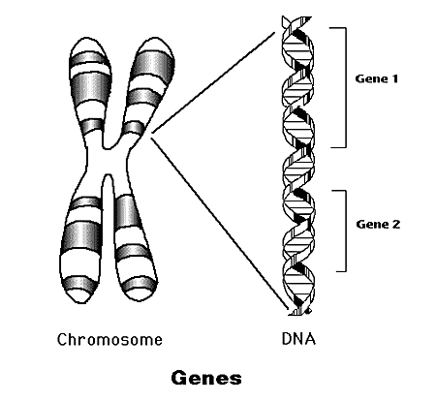
Genetic Information
Gene – basic unit of genetic information. Genes determine the inherited characters.
Genome – the collection of genetic information.
Chromosomes – storage units of genes.
DNA - is a nucleic acid that chromosomes are made of and that is found in the nucleus of every cell of all living things.
Notes:
Image from http://www.accessexcellence.com/AB/GG/

Slide 3
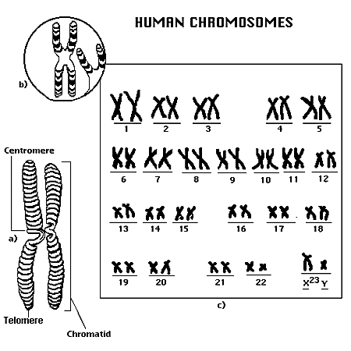
Human Genome
Most human cells
contain 46 chromosomes:
2 sex chromosomes (X,Y):
XY – in males.
XX – in females.
22 pairs of chromosomes named autosomes.
Who determines the sex of the child? The mom or dad?
Notes:
Image from http://www.accessexcellence.com/AB/GG/

Slide 4
Chromosome Logical Structure
Locus – location of a gene/marker on the chromosome.
Allele –A different form that a gene may have for a specific trait at a particular locus.
Locus1
Possible Alleles: A1,A2
Locus2
Possible Alleles: B1,B2,B3

Slide 5
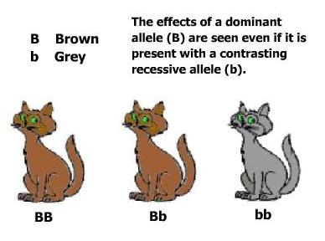
Dominant vs. Recessive
A dominant allele means that one trait covers over or masks another form of the trait.
A dominant allele is expressed (shows up) even if it is paired with a recessive allele.
A recessive allele means that the trait is hidden or masked if the dominant form of the trait is present.
A recessive allele is only visible when paired with another recessive allele.

Slide 6
Alleles
T – is considered a dominant allele
t – is considered a recessive allele
TT – is dominant
Tt or tT – is dominant
tt - is recessive

Slide 7
Genotypes Phenotypes
At each locus (except for sex chromosomes) there are 2 genes. (One from the male and the other from the female) These constitute the individual’s genotype at the locus. (Take the first letter of the dominant gene)
The expression (how the trait appears) of a genotype is termed a phenotype. For example, hair color, weight, or the presence or absence of a disease.

Slide 8
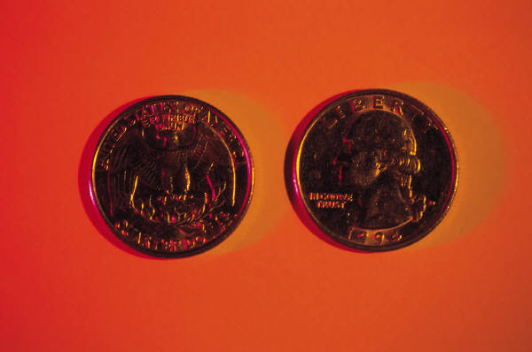
Genotype
A combination of alleles
Example: TT, Tt, or tt
*We flipped coins to determine the genotype of our critters and puppies.

Slide 9
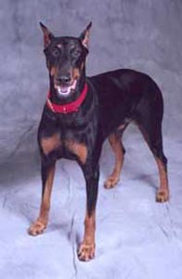
Phenotype
They are the traits determined by reading the genotype.
Example : FF = black fur
Black fur is the phenotype or trait

Slide 10
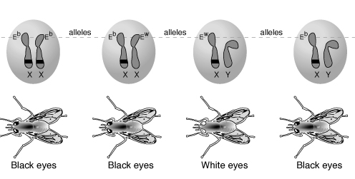
Genotypes Phenotypes (example)
genotypes
phenotypes
E^{b}- dominant allele.
E^{w}- recessive allele.

Slide 11
What is HOMOZYGOUS?
Both alleles (forms of the gene) are the same
When offspring inherit two dominant genes, (one dominant gene from each parent) they are said to be homozygous dominant.
When offspring inherit two recessive genes, (one recessive gene from each parent) they are said to be homozygous recessive.

Slide 12
What is HETEROZYGOUS
When alleles occur in different forms
When offspring inherit one dominant gene and one recessive gene, they are said to be heterozygous
Since the dominant gene will be expressed, they are said to be heterozygous dominant

Slide 13
Describe CO-DOMINANCE
When an organism has two different alleles for a gene that does not follow the dominant/recessive pattern.
The organism shows a trait that is a blend of the traits represented by the two alleles.
Also called INCOMPLETE DOMINANCE

Slide 14
Describe CO-DOMINANCE
FOR EXAMPLE:
The gene for the color of some flowers has one allele for red and one for white. When both alleles are present, neither is dominant, and the flower color is pink

Slide 15
What is a PUNNETT SQUARE?
A tool to predict the probability of certain traits in offspring that shows the different ways alleles can combine
A way to show phenotype & genotype
A chart that shows all the possible combinations of alleles that can result when genes are crossed.

Slide 16
What is a PUNNETT SQUARE?
Letters stand for dominant and recessive alleles
An uppercase letter stands for a dominant allele
Lowercase letters stand for recessive alleles

