Slide 1
Level 2
Mapping Sea Level From Space

Slide 2
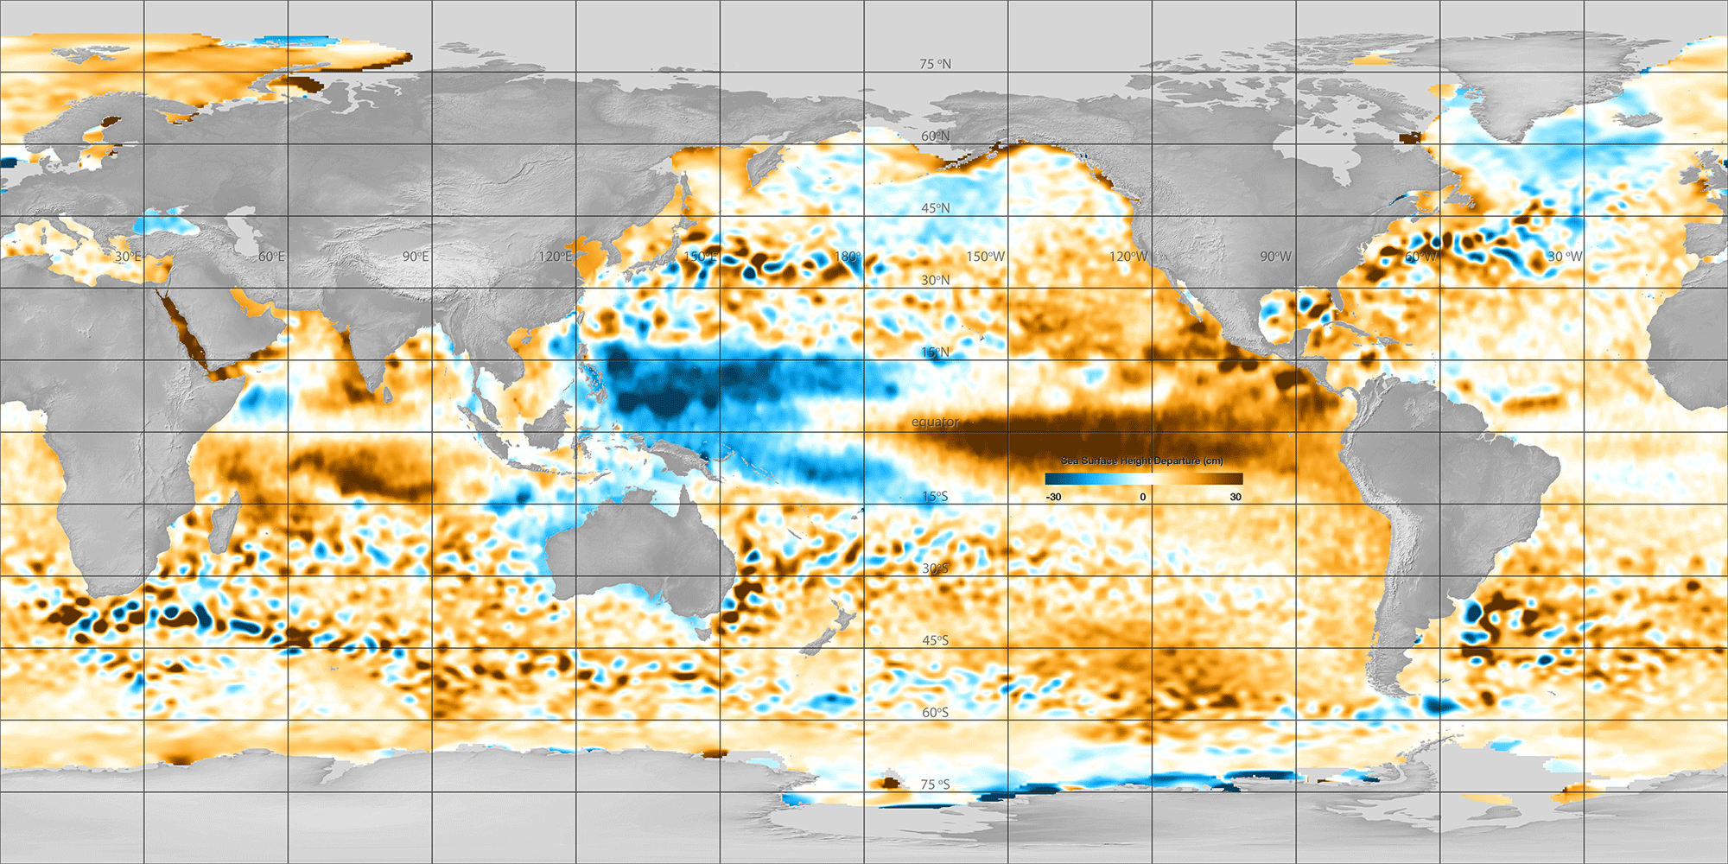
Mapping Sea Surface Height Deviation – January 2016

Slide 3
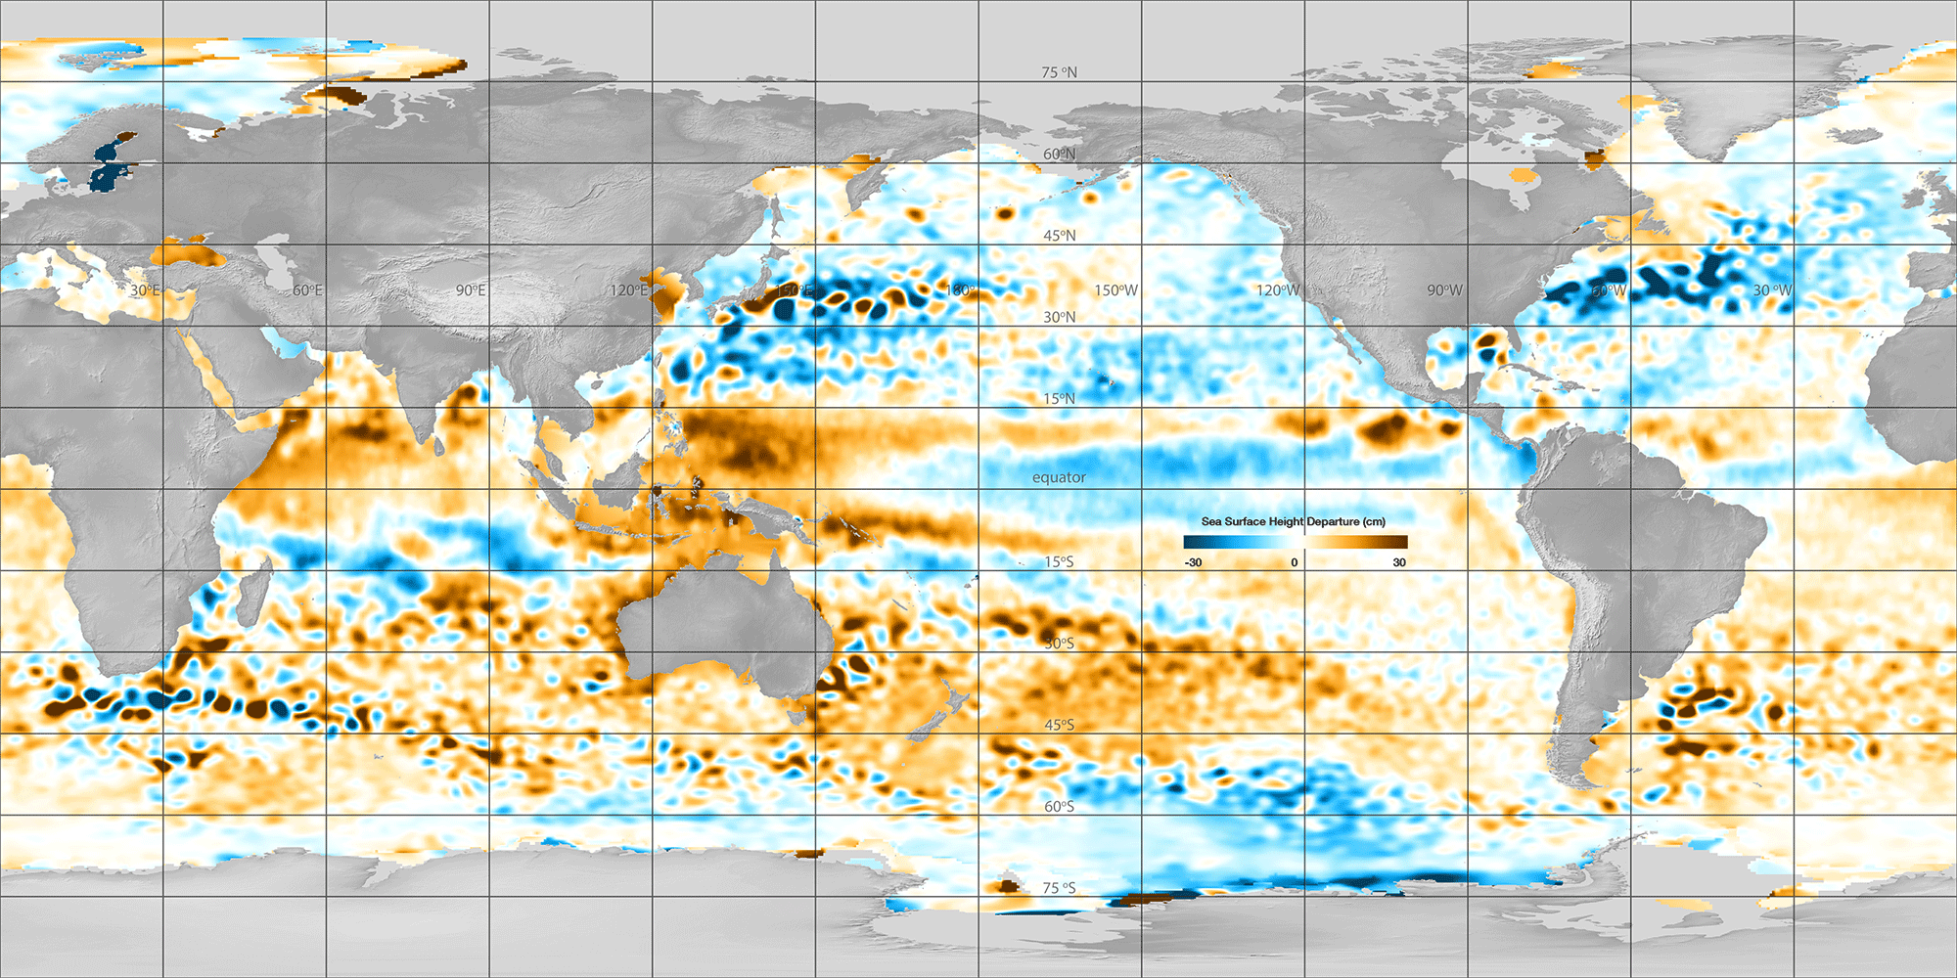
Analyzing SSHD Maps – April 2013

Slide 4
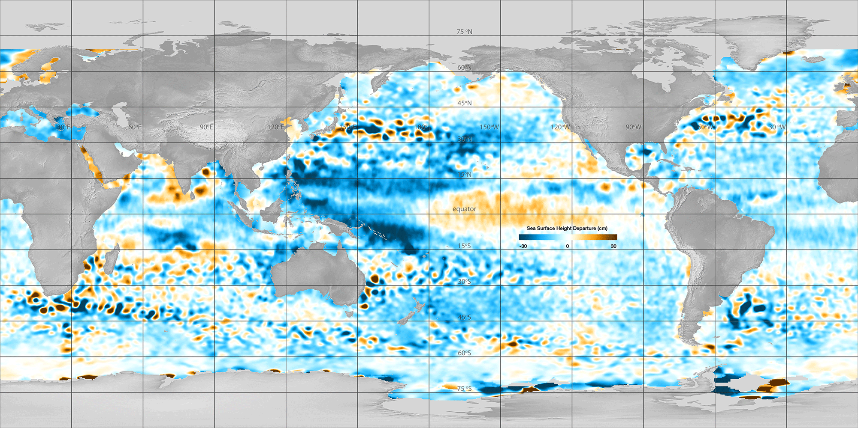
Comparing Change Over Time – Map #1 January 1993

Slide 5
Comparing Change Over Time – Map #2 January 2016

Slide 6
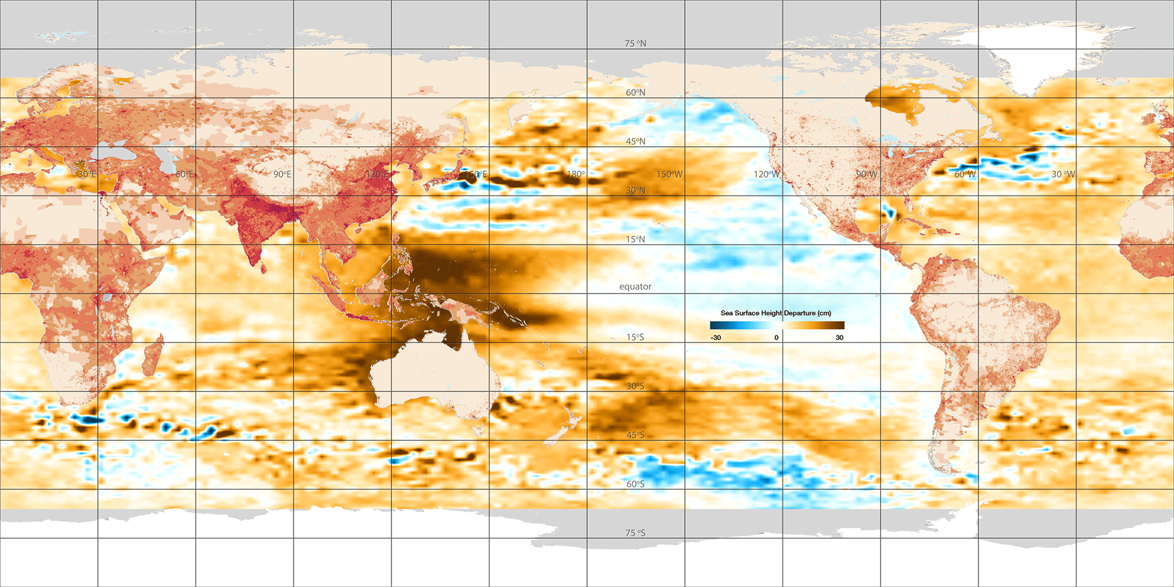
Global Sea Level Trends – Population and Sea Level Trend

